Slide 1
The eSports Ecosystem and its Effects on Modern Society
AP Seminar
Performance Task 1
Team Multimedia Presentation
Nick, Jaden, Craig, Eric

Slide 2
eSports
An organized competitive scene centered around video gaming.
Began in 1970s and has continued into today's era
Varies from team-oriented games such as League of Legends, to speedrunning the classics such as Mario.

Slide 3
Does eSports provide a lucrative opportunity for investors and sponsors?

Slide 4
What research strategies were utilized?
Societal and Cultural Impact
Historical Impact
Economic Impact
Future Impact

Slide 5
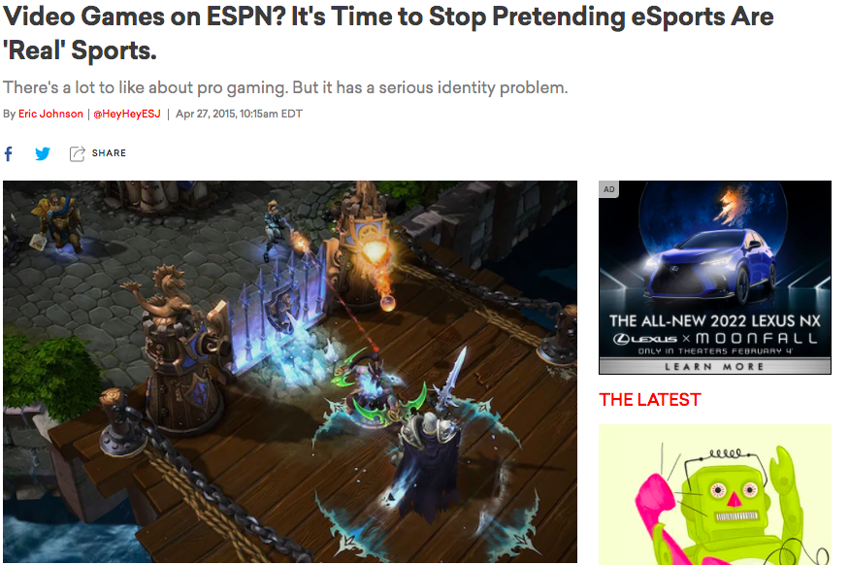
Societal/Cultural Impact
"It's time to stop pretending eSports are real sports"
$2.2 Billion in estimated market value for 2022

Slide 6


Societal/Cultural Impact
100 Thieves was founded in 2017
100 Thieves raked $2.5 million in one month on one merchandise line

Slide 7
Historical Impact of eSports
Began with the Spacewars Olympics of 1972
Developed organizations such as Major League Gaming, Cyberathelete Professional League, World Cyber Games

Slide 8
Historical Impact of eSports
Launch of Twitch.tv by Justin Kan
Sponsorships and promotions raise millions for tournaments

Slide 9
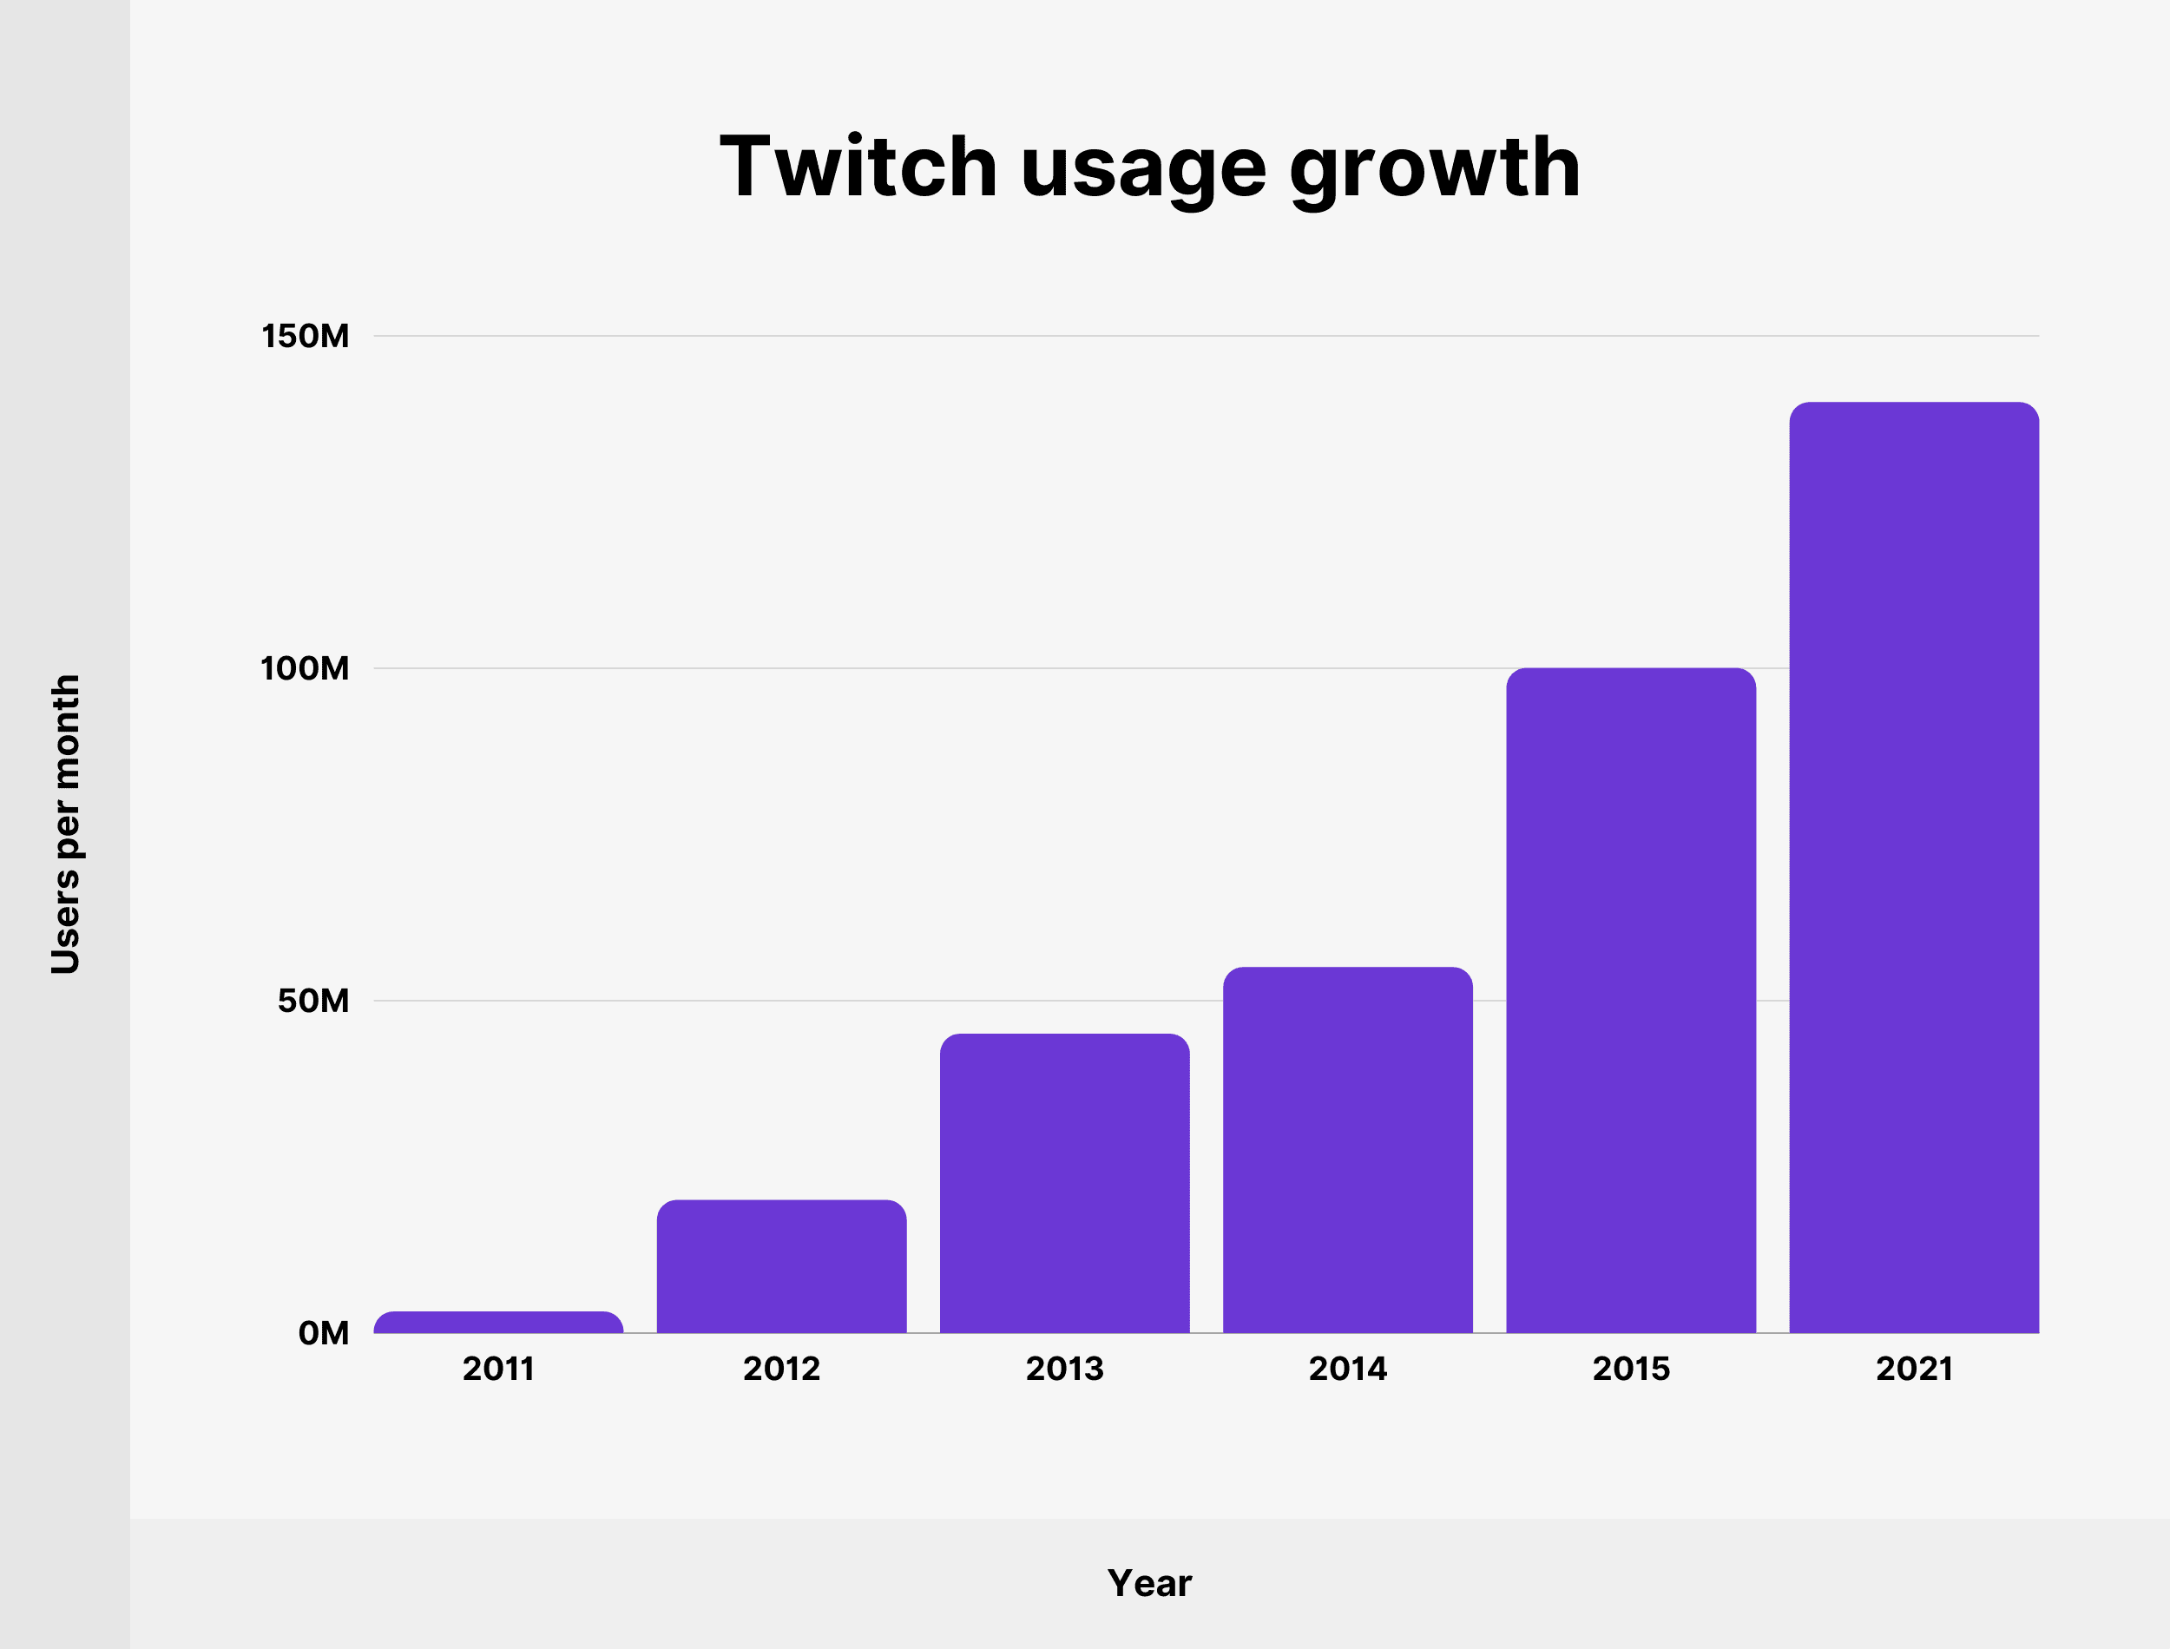

Slide 10
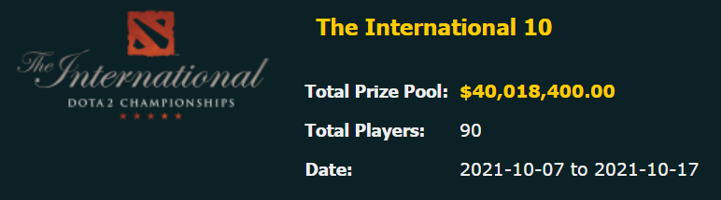
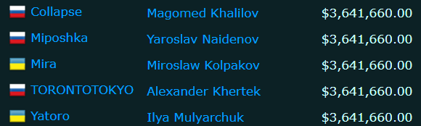

Slide 11
Economic Impact
Homo Economicus
Individual Interest
Consumer Impact
The Relation Between Advertisers, Game Companies, and the Individual
The Starting Point of a Prevalent Game
Vertical Integration
The Influence of a Game Company

Slide 12
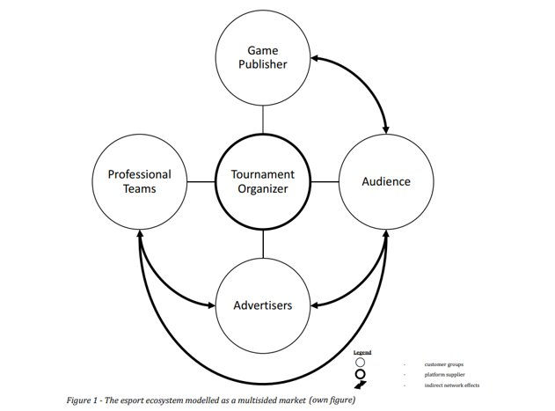

Slide 13
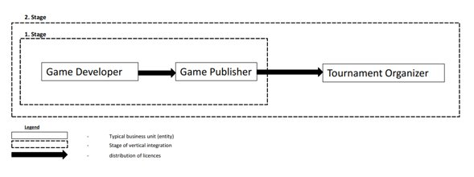

Slide 14
Economic Impact
Sponsorship
Prize Money
Steady Income
Streaming
Merchandise

Slide 15
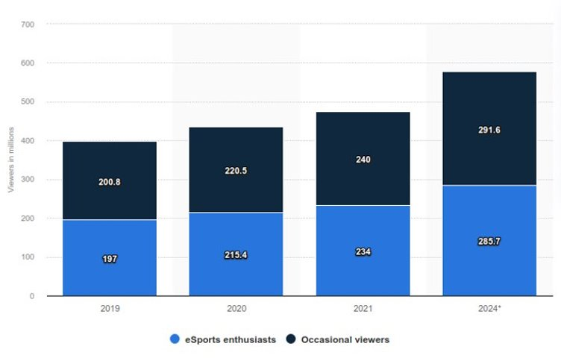
eSports audience size worldwide from 2019 to 2024, by type of viewers

Slide 16
Future Impacts
Elite competitions.
Pandemic Contribution.
Compound AGR of 12.9% from 2020 - 2027.

Slide 17
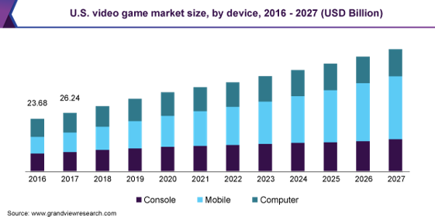

Slide 18
Conclusion
Esports is a beneficial opportunity for investors and sponsors.
Internet culture creates a large circle of fans stimulating the economy.

Slide 19
References
100 thieves rake in $2.5m from 'foundations' apparel line in first month. Dexerto. (2021, September 21). Retrieved February 24, 2022, from https://www.dexerto.com/esports/100-thieves-foundations-apparel-revenue-2-5m-1657942/
Newzoo's Global Esports & Live Streaming Market Report 2021: Free version. Newzoo. (2022, January 17). Retrieved February 24, 2022, from https://newzoo.com/insights/trend-reports/newzoos-global-esports-live-streaming-market-report-2021-free-version/
Miyakoshi, Kengo. The Economics of Esports. USC Economics Review, 4 Jan. 2019, https://usceconreview.com/2019/01/04/the-economics-of-esports.
BER. The Explosive Growth of Esports. Berkeley Economic Review, 24 Oct. 2018, https://econreview.berkeley.edu/the-explosive-growth-of-esports/.
Nießen, Jan Henrik. A Sports Economic Analysis of Esports with Regard to Market Structure and Competitive Balance. Deutsche National Bibliothek, Technische Universität Ilmenau, 14 Aug. 2020, https://d-nb.info/1220226610/34.
Research, Grandview. “Video Game Market Size, Share: Industry Report, 2020-2027.” Video Game Market Size, Share | Industry Report, 2020-2027, https://www.grandviewresearch.com/industry-analysis/video-game-market.

